Slide 1
Temporal Tables - باللغة العربية
Ayman El-Ghazali

Slide 2
What are Temporal Tables?
System-versioned database feature that allows for tables to be queries at a point in time
Table keeps a full history of data modifications to allow for point-in-time analysis of data
New feature for SQL 2016 available in all editions

Slide 3
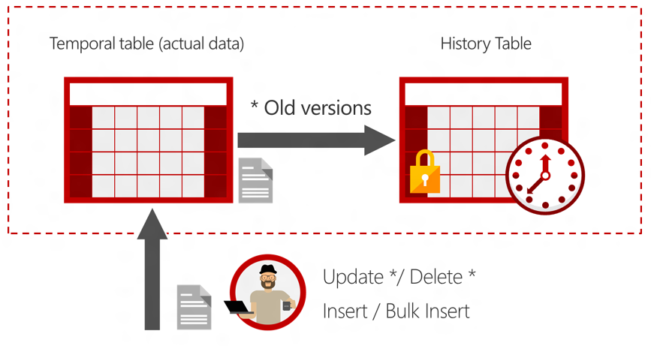
How does it work?
https://i-msdn.sec.s-msft.com/dynimg/IC841002.jpeg

Slide 4
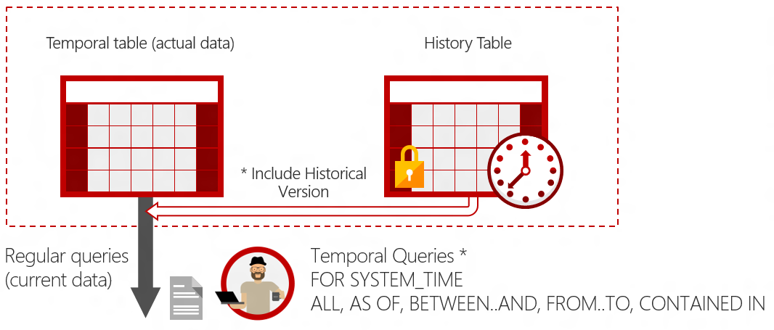
How does it work?
https://i-msdn.sec.s-msft.com/dynimg/IC841002.jpeg

Slide 5
How to create a Temporal Table
Create Table dbo.Table ( Column1…. ValidFrom datetime2 GENERATED ALWAYS AS ROW START DEFAULT GETDATE(), ValidTo datetime2 GENERATED ALWAYS AS ROW END DEFAULT CONVERT(DATETIME2, '9999-12-31 23:59:59.99999999') PERIOD FOR SYSTEM_TIME (ValidFrom, ValidTo) ) WITH (SYSTEM_VERSIONING = ON (HISTORY_TABLE = dbo.TableHistory) )

Slide 6
Alter Existing Table
ALTER TABLE Table ADD PERIOD FOR SYSTEM_TIME (ValidFrom, ValidTo), ValidFrom datetime2 GENERATED ALWAYS AS ROW START DEFAULT GETDATE(), ValidTo datetime2 GENERATED ALWAYS AS ROW END DEFAULT CONVERT(DATETIME2, '9999-12-31 23:59:59.99999999') ALTER TABLE dbo.Table SET (SYSTEM_VERSIONING = ON (HISTORY_TABLE = dbo.TableHistory));

Slide 7
Querying the History Table
SELECT * FROM Table FOR SYSTEM_TIME
BETWEEN '2016-01-01' AND '2017-01-01'
WHERE Column1 = 11000
ORDER BY ValidFrom;

Slide 8
Additional Information
If a history table is not specified, an auto-generated table is created and used
A History table can only contain history data from one table
Cannot drop the main table until SYSTEM_VERSIONING is turned off
Compatible with Stretch Database and Table Partitioning
These solutions can help with data archival and deletion of old data
Can create custom archival solution to clean up historical data that is not needed anymore
Always-On Availability groups fully supported
Snapshot and Transactional Replication support for Subscriber
Good scenario for using temporal tables on the Subscriber to an OLTP system where the Temporal Table will be used for history reporting
Only one Publisher and subscriber supported in the topology

Slide 9
Demo
Temporal Tables

